Slide 1

Final Project
t.gillett

Slide 2
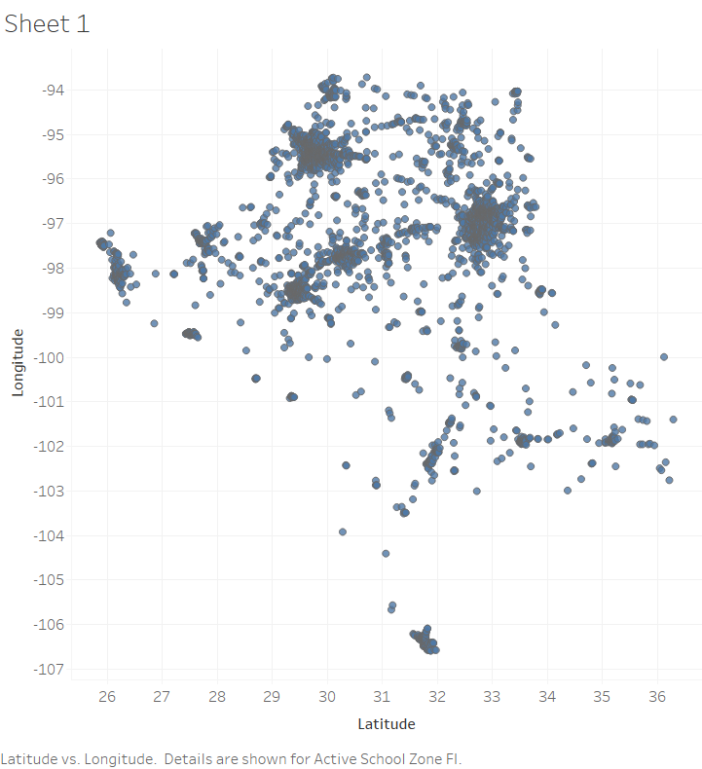
ACTIVE SCHOOL ZONE
This is displaying cluster concentration areas in 4 major locations:
Lat 32.86, 29.84, 30.39, 29.56
Long -97.04, -95.36, -97.83, -98.48

Slide 3
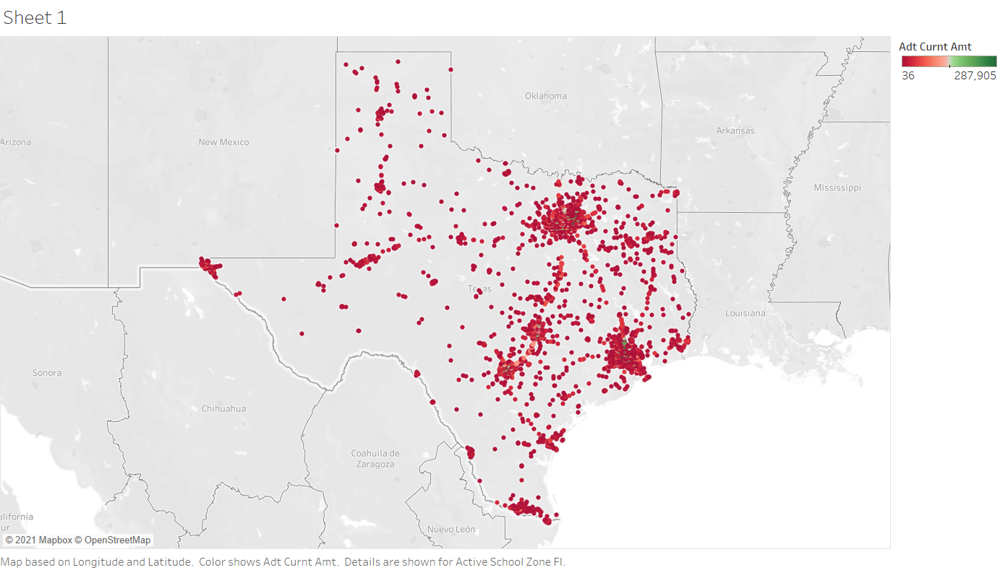
Where& how Are We dispersing?
Now we can see how many are in each cluster location on the map.

Slide 4
As we zoom closer to each cluster, we see where the larger populations are trending

Slide 5
Crashes Per Day of Week
As you can see, there tends to be more accidents on Tuesdays.

